Slide 1
Prophesy Fulfilled
The Savior foretold the signs of His second coming—
are those signs fulfilled?

Slide 2
Commanded to Watch
  Luke 21:36 Watch ye therefore, and pray always (and keep my commandments), that ye may be accounted worthy to escape all these things that shall come to pass, and to stand before the Son of man (when He shall come clothed in the glory of His Father).
  My observations; not revelation, vision or dreams
  .

Slide 3
Christ’s Prophesy of Second Coming
  The disciples asked the Lord when he would come again (5 versions)
  Matthew 24 … the sign of thy coming and of the end of the world?
  (JS Matthew)
  Mark 13 …Peter and James and John and Andrew …Tell us, when shall these things be? And what shall be the sign when all these things shall be fulfilled?
  Luke 21 …Master, but when shall these things be? And what sign…
  D&C 45 …As ye have asked of me concerning the signs of my coming, in the day when I shall come in my glory…
  All sources:
  Signs and trials, parable of the fig tree, commandment to WATCH.
  Watch for what?

Slide 4
Christ’s Prophesy in Luke
  Matthew and Mark mix the signs of the temple destruction and the second coming. In Luke, the apostles ask about signs of the two events separately.
    Luke 21:6 As for these things which ye behold, the days will come, in the which there shall not be left one stone upon another, that shall not be thrown down.
    7 And they asked him, saying, Master, but when shall these things be? And what sign will there be when these things shall come to pass?
  Why was the temple to be destroyed and Israel scattered?
    Wickedness, hypocrisy, broken covenants and commandments (Mat. 11:23, 12:34, 15:7-9)
    Rejected the Messiah
  Same reasons for the tribulations of the Last Days.

Slide 5
Signs before Temple Destruction
  False Christs
  Wars and commotions
  Earthquakes, famines and pestilences
  Signs shall there be from heaven.
  12 Apostles persecuted, some put to death
  Did these things happen according to Christ’s prophesy?
  Josephus
  Roman history
  Josephus and Tacitus
  Josephus
  Christian history

Slide 6
Heed the Signs!
  Luke 21:20 And when ye shall see Jerusalem compassed with armies, then know that the desolation thereof is nigh.
    Judea flee!
    Sorry if you are with child! Great distress, wrath upon this people.
    Fall by the sword, led away captive.
  Did Judaea and Jerusalem fall as Christ foretold?

Slide 7
Prophesy Fulfilled
  The temple was destroyed in 70 AD as prophesied
  Jerusalem compassed with armies (left inexplicably)
    Judea attacked, not just Jerusalem
  Distress, wrath:
    Over 60,000 Roman troops to Jerusalem.
    Jerusalem full due to Passover and refugees from surrounding areas.
    Seven month siege. Famine! “No other city ever endured such miseries.” (Josephus)
  Fall by the sword:
    Crucified surrounded the city until there was no more room
    Josephus reported 1.1 million dead (others report at least 600,000).
  Led away captive unto all nations:
    97,000 prisoners sold as slaves and taken to other nations.
  Jerusalem shall be trodden down of the Gentiles:
  The temple is burned on the same day in the Jewish calendar that the previous temple was destroyed. Titus orders the city and Temple to be razed to the ground. City destroyed.
  Prophesy fulfilled! What about the Christians?

Slide 8
Christians Heeded the Warning
“The whole body, however, of the church at Jerusalem, having been commanded by a divine revelation, given to men of approved piety there before the war, removed from the city.” Eusebius
“It is very remarkable that not a single Christian perished in the destruction of Jerusalem, …” Epiphanes
Our leaders will again instruct us to flee our homes, will we?

Slide 9
Today’s Warnings
  Then came the signs of His second coming:
  Luke 24-27 JST: Now these things he spake unto them, concerning the destruction of Jerusalem. And then his disciples asked him, saying, Master, tell us concerning thy coming? And he answered them, and said, In the generation in which the times of the Gentiles shall be fulfilled,) there shall be…

Slide 10
Watch for These Signs
  …signs in the sun, and in the moon and in the stars;
  CELESTIAL SIGNS
  and upon the earth distress of nations, with perplexity;
  DISTRESS OF NATIONS
  the sea and waves roaring; (The earth also shall be troubled, and the waters of the great deep;)
  NATURAL DISASTER
  Men’s hearts failing them for fear, and for looking after those things which are coming on the earth: for the powers of heaven shall be shaken.
  FEAR FROM EVENTS AND HEAVEN’S POWER SHAKEN
  And then shall they see the Son of man coming in a cloud with power and great glory.

Slide 11
The Parable of the Fig Tree
  Luke 21: 29 And he spake to them a parable; Behold the fig tree, and all the trees;
  30 When they now shoot forth, ye see and know of your own selves that summer is now nigh at hand.
  31 So likewise ye, when ye see these things come to pass, know ye that the kingdom of God is nigh at hand.
  When what things come to pass? THE SIGNS

Slide 12
Time of the Gentiles
  Christ says “of that day and that hour knoweth no man” but immediately and repeatedly refers to the generation that will witness His coming
  32 Verily I say unto you, this generation, (JST: the generation when the times of the Gentiles be fulfilled), shall not pass away, till all be fulfilled. Heaven and earth shall pass away: but my words shall not pass away.
  Pres. Benson: The “times of the Gentiles” refers to that period of time extending from when the gospel was restored to the world (1830)”
  When is the time of the Gentiles fulfilled?

Slide 13
Time of the Gentiles-Fulfilled
  Luke 21: 24 And Jerusalem shall be trodden down of the Gentiles, until the times of the Gentiles be fulfilled
  D&C 45:24-25 And this I have told you concerning Jerusalem; and when that day shall come (destruction of the temple), shall a remnant be scattered among all nations; But they shall be gathered again; but they shall remain (scattered) until the times of the Gentiles be fulfilled.
  Gentiles populated Jerusalem until 1967 when the Jews returned. So, if the times of the gentiles was fulfilled, that generation will not pass away until all is fulfilled.
  What is the significance of generations?
    Prophesies and powers, judgment and retribution, promises and blessings

Slide 14
Luke’s Generation Timeline
4000 BC
3000
2000
1000
0
1000 AD
2000AD
77 generations
2019/77 = 26.2 years per generation
God
Christ
“whose life is central to all human history”
Came in the “meridian of time”
Chiasmus?

Slide 15
Chiasmus Across Centuries
4000 BC
3000
2000
1000
0
1000 AD
2000
3000
Coincidence?
Death of
Joseph of Egypt
1805 BC*
Birth of Joseph Smith
1805 AD
*1 Kings 6:1, dates the Exodus 480 years before the fourth year of Solomon, accepted by virtually all scholars as 966 BC. This places the Exodus in ca. 1446 BC; Exodus 12:40 states that Jacob came to dwell in Egypt 430 years before the Exodus. Thus he came to Egypt in ca. 1876 BC. Bible says he died 71 years after coming to Egypt which is 1805 BC.

Slide 16
Generations
Is the prophesied generation alive today?
Pres. Benson reviewed the same prophesies of Christ and then declared:
“Youth of Zion, do you realize you are living in the days of the fulfillment of these signs and wonders? You are among those who will see many of these prophecies fulfilled. Just as certain as was the destruction of the temple at Jerusalem and the scattering of the Jews, so shall these words of the Savior be certain to your generation.”
(1982 BYU Devotional, May New Era– Prepare Yourself for the Great Day of the Lord)

Slide 17
Jewish Numerology
  Speech by Israel Prime Minister Netanyahu to the United Nations
  9/19/17 referring to the historic year 2017 - Jewish year 5777
  (Jubilee Year = Year following 7 Shemitas {Sabbath Years} of 7 years)
  120 years ago (1897): first Zionist conference organized by Theodore Herzel-Modern Moses
  100 years ago (1917): Balfour declaration giving Jews the right to a national homeland. (Jubilee).
  70 years ago (1947): U.N. declared the rights of the Jews to a national homeland
  50 years ago (1967): Jews returned to Jerusalem (Jubilee)
  Was 2017 significant? Take note in the following slides.

Slide 18
Note the significance of #7
  What is the significance of the number 7 to the Jews?
    The number 7 is the Divine number of completion
    A covenant promise (in Hebrew, the expression literally translated as “to seven oneself” means “to swear a covenant”)
    The general symbol for all association with God; the favorite religious number of Judaism, typifying the covenant of holiness and sanctification, and also all that was holy and sanctifying in purpose.
    The Seventh Day, the Sabbath
    Seven used 54 times in the book of Revelations

Slide 19
Is it Time to Watch?
  Luke 21: 34 And take heed to yourselves, lest at any time your hearts be overcharged with surfeiting (GR debauchery, TG rioting and reveling), and drunkenness, and cares of this life, and so that day come upon you unawares.
  35 For as a snare shall it come on all them that dwell on the face of the whole earth.
  36 Watch ye therefore, and pray always (JST and keep my commandments), that ye may be accounted worthy to escape all these things that shall come to pass, and to stand before the Son of man (when He shall come clothed in the glory of His Father).
  We are commanded to watch, pray and obey in order to escape the judgments.
  Watch for what? Pray for what? Obey what?
  What are the latter-day prophets saying?

Slide 20
Surely our Prophets would warn us!
Pres. Benson: Knowing what we know as His servants, can we hesitate to raise a warning voice to all who will listen that they may be prepared for the days ahead? Silence in the face of such calamity is sin! (Prepare Yourself for the Great Day of the Lord.)
Joseph Fielding Smith: “The day of the coming of the Lord is near…I sincerely believe it will come in the very day when some of us who are here today will be living upon the face of the earth. That day is close at hand. (President Joseph Fielding Smith—General Conference, April 1936—83 years ago)
What about our living Prophet and Apostles?

Slide 21
Living Prophets and Apostles
Elder Nelson: The Gathering of Scattered Israel 10/6, Now is the Time to Prepare 4/05, The Price of Priesthood Power 4/16, Youth Broadcast 6/18, Just about every talk.
Elder Eyring: Hearts Bound Together 4/05 “We live in the last days. Time could be running out for us to do what we have promised to do.”
Elder Oaks: Preparation for the Second Coming 4/04 (Highly Recommended)
Elder Uchtdorf: Perfect Love Casteth Out Fear 4/17 “Brothers and sisters, we are charged with studying the word of God and heeding the voice of the Spirit, that we may “know the signs of the times, and the signs of the coming of the Son of Man.”
Elder Ballard: Regional Conference 9/16.
Elder Hales: Preparation for the Restoration and the Second Coming 10/05
Elder Holland: Preparing for the Second Coming 12/13 Ensign (from Church Education Fireside “Terror, Triumph and a Wedding Feast 9/04)
Elder Bednar: Watching with All Perseverance 4/10 “Spiritual warnings should lead to increasingly vigilant watching. You and I live in “a day of warning” (D&C 63:58). And because we have been and will be warned, we need to be, as the Apostle Paul admonished, “watching…with all perseverance” (Ephesians 6:18)
Elder Cook: Let There Be Light! 10/20, We Follow Jesus Christ 4/10
Elder Christofferson: “the Holy Spirit affirmed two things to me… it is supremely important to prepare the world for the Second Coming of the Lord Jesus Christ.” 4/19
Elder Anderson: Preparing the World for the Second Coming 4/11, Thy Kingdom Come 4/15

Slide 22
President Nelson, Our Prophet
Just think of the excitement and urgency of it all: every prophet commencing with Adam has seen our day. And every prophet has talked about our day, when Israel would be gathered and the world would be prepared for the Second Coming of the Savior. Think of it! Of all the people who have ever lived on planet earth, we are the ones who get to participate in this final, great gathering event. How exciting is that! Our Heavenly Father has reserved many of His most noble spirits﻿—perhaps, I might say, His finest team﻿—for this final phase. Those noble spirits﻿—those finest players, those heroes﻿—are you!
“Our Savior and Redeemer, Jesus Christ, will perform some of His mightiest works between now and when He comes again. We will see miraculous indications that God the Father and His Son, Jesus Christ, preside over this Church in majesty and glory,” (“Revelation for the Church, Revelation for Our Lives,“ Apr. 2018 general conference).
“Do the spiritual work to find out for yourselves, and please do it now. Time is running out.”
Are members of the church preparing? What percent believe its soon and are actively preparing?

Slide 23
Latter Day “Scoffers”
2 Peter 3: 3 …there shall come in the last days scoffers, walking after their own lusts, and saying, Where is the promise of his coming? For since the fathers fell asleep, all things continue as they were from the beginning of the creation.
8 But, beloved, be not ignorant of this one thing, that one day is with the Lord as a thousand years, and a thousand years as one day.
Jews and saints: 7 days of man, each day a thousand years = 4 days until Messiah, 2 to tribulation, 1 for Millennium Was Peter reminding the saints of the significance of the year 2000 and predicting “scoffers” in our day?
LDS.org, D&C 77:12; Seventh seal opened around 2,000. Then ½ hour of silence in heaven (20.8 years). Then tribulations.
“But perhaps these days are more “latter” than we have ever imagined.” Sister Nelson

Slide 24
Why Now?
  The reason is the same as for the judgment in Christ’s time:
  Broken Covenants
    Abrahamic
    Nephite
    American
  Broken Commandments
    10 Commandments
      Mocking God
      Immorality, Porn $12 B in U.S., $100 B globally
      Breaking Sabbath
  Rejecting the Messiah
    Sorry, no time to review facts and statistics tonight.

Slide 25
Wickedness brings the Signs of Judgment!
Christ’s Prophesied Signs
Celestial Signs
Distress of Nations
Natural Disasters
Fear, Heavens Shaken

Slide 26
Celestial Signs
Sun darkened
Isaiah 13:10, Joel 2:10, 31; 3:15, Matt. 24:29, Mark 13:24, Luke 21:25, Acts 2:20, 2 Nephi 23:10, Rev. 6:12, 8:12, D&C 29:14, 34:9, 45:42, 133:49
Moon turned to blood (darkened)
Isaiah 13:10, 24:23, Ezekiel 32:7-8, Joel 2:10, 31, 3:15, Matt. 24:29, Mark 13:24, Luke 21:25, Acts 2:20, Rev. 6:12, 2 Nephi 23:10, D&C 29:14, 34:9, 45:2, 133:49
Stars Falling
Matt. 24;29, Luke 21:25, Rev. 6:12, 8:10, 8:12, D&C 133:49

Slide 27
Already Happened?
  President Hinckley: “The vision of Joel has been fulfilled wherein he declared: ‘And it shall come to pass afterward, that I will pour out my spirit upon all flesh; and your sons and your daughters shall prophesy, your old men shall dream dreams, your young men shall see visions: And also upon the servants and upon the handmaids in those days will I pour out my spirit. And I will shew wonders in the heavens and in the earth, blood, and fire, and pillars of smoke. The sun shall be turned into darkness, and the moon into blood, before the great and the terrible day of the Lord come…” (Joel 2:28-32) (GC Oct 2001)

Slide 28
Celestial Signs
What heavenly signs should we expect?
  Matthew 16:4 The Pharisees also with the Sadducees came, and tempting desired him that he would shew them a sign from heaven. (Sign in Hebrew means constellation. Healings and raising people from the dead were not enough, the Jews believed in heavenly signs.)
  ”He answered and said unto them, When it is evening, ye say, It will be fair weather: for the sky is red. O ye hypocrites, ye can discern the face of the sky; but can ye not discern the signs of the times? A wicked and adulterous generation seeketh after a sign; and there shall no sign be given unto it, but the sign of the prophet Jonas.

Slide 29
Sign of Jonah
  What sign in the heavens represented Jonah, death and the resurrection of Christ (Matt 12) and is designated as the Sign of the Times? A sign that was remembered 760 years later when referred to by Christ.
  Question: Did the king and whole city of Ninevah repent in sack cloth and ashes just because of a sermon by a reluctant prophet?

Slide 30
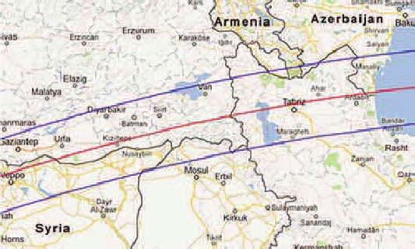
Sun Darkened
The great Assyrian eclipse
  June 15, 763 BC (during the life of Jonah) was the famous Bur-Sagale Eclipse just north of Ninevah.
  There were also earthquakes, plagues and revolts.
  Was it any wonder that when Jonah visited them and warned of their destruction they put on sackcloth and ashes and repented?
The ancient city of Ninevah

Slide 31
Sign of Jonah was Given
The Sign at Christ’s death
Matthew, Mark and Luke describe darkness for three hours when Christ died. Matthew also mentioned an earthquake. As Christ prophesied, they saw the sign of Jonah but unlike Ninevah, they did not repent.
Book of Mormon: three days of darkness at the time of Christ’s death (3 Nephi 11:11) as well as storms and earthquakes. (3 Nephi 8)
The “sign of Jonah” was given at the time of Christ’s death. The “Sign of the Times.”
Has that same sign been seen recently?

Slide 32
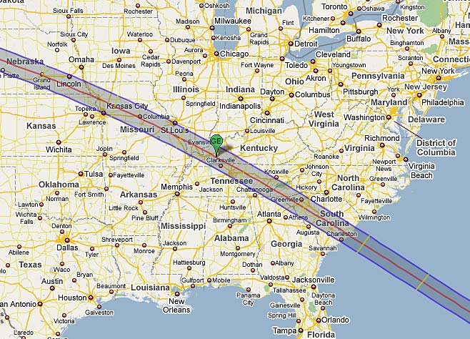
Sign of Jonah, a Sign of His Second Coming?
The Great American Eclipse
August 21, 2017
  First total eclipse only visible in the U.S. since
  country was founded in 1776
  First to sweep across the entire country in 99 years
  Darkness started over the U.S. at the same moment that the sun set over Jerusalem. First significant city hit by the eclipse was Salem—named after Jerusalem (7 Salems crossed).
  On the first day of Elul, 1st day of the 12th month of year 5777 on the Jewish Calendar. (Month of divine mercy and forgiveness—Moses ascends mount)

Slide 33
Sun Darkened
  Connects Independence and Adam-ondi-Ahman

Slide 34
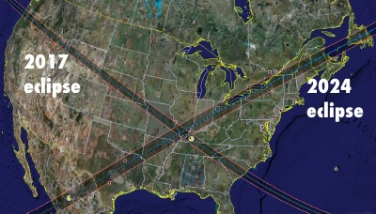
Next U.S. Eclipse?
  7 years later, April 8, 2024, combined time of the two = 7 minutes
Palmyra, New York
Adam-ondi-Ahman
Kirtland, Ohio

Slide 35
Blood Moons
The sun shall be turned into darkness, and the moon into blood, before the great and the terrible day of the Lord come…” (Joel 2:28-32, Pres. Hinckley-Fulfilled)
Seven Tetrads (4 blood moons in a row) on Jewish holidays since crucifixion. They seem to coincide with significant events.
  162-163 AD—Worst persecution of Jews and Christians of Roman Empire, 1/3 of population killed by plague
  795-796 AD—Charlemagne ended centuries of Arab invasions into Western Europe
  842-843 AD—Vatican attacked and looted by Islamic invasion
  860-861 AD—Byzantine Empire defeated Arab armies and stopped the Islamic invasion of Eastern Europe
  1493-1494—All Jewish people ordered to leave Spain, 200,000 people. Columbus discovered America which became the refuge for Jews.
  1949-1950—First Arab-Israeli War for Independence. First Jewish government in Israel took office on January 25th, 1949.
  1967-1968—Six Day War when Israel recaptured Jerusalem.
  2014-15—Sextet of Blood Moons

Slide 36
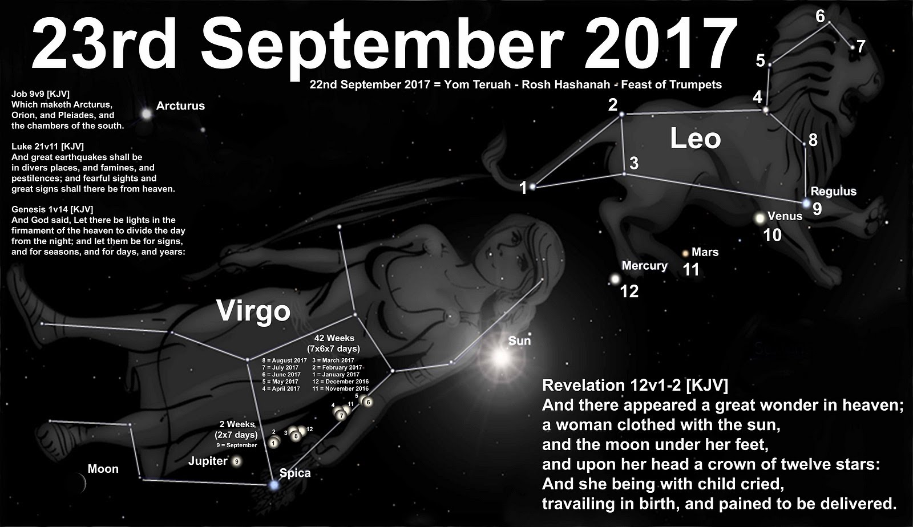
Wonder in Heaven
2017, again
Revelation 12
A great wonder in heaven…
A woman
  Clothed with the sun
  Moon under her feet
  Crown of twelve stars
  With child, a ruler of all nations
  Dragon tries to swallow child
  Woman flees into the wilderness (3.5 yrs.)

Slide 38
Sign of the Woman
Three occurrences, all on the Feast of the Trumpets
The Feast of the Trumpets on the first day of the seventh month symbolizes the seven angels blowing the seven trumpets at the beginning of the Millennium.
Joseph Smith explanation:
  Woman = the church of God,
  Child = the kingdom of God and his Christ.

Slide 39
Sign of the Woman
Date | Event | Threat | Wilderness (1260 days) | Note
2 BC Aug 30 | Birth of Jesus Christ | Herod determined to kill the Messiah | Mary and Joseph fled to Egypt (for 3.5 years?)
1832 Sept. 26 | Birth of the Kingdom of God (First General Conference in Zion 1833) | Church threatened by mobs, fled from Missouri (Eden) | To Kirtland which was safe for 3.5 years: 111 of 138 D&C sections given, Kirtland temple dedicated. “for some time Satan has not had power to tempt you. Some have thought that there would be no more temptation. But the opposite is true, and unless you draw near to the Lord you will be overcome and apostatize.” JS 1836-1838, Satan unloosed. Three witnesses and half of twelve apostatized. | Stars cast down to earth by the dragon fulfilled by largest meteor shower in recorded history, while saints were fleeing. (Nov 13, 1833) Prevented an attack.
2017 Sept. 23 | Heralding Re-birth? | Internet? | In the wilderness and protected for 1260 days (3.5 years). To March 5, 2021. | Also about 20.8 years from 7th seal opening.

Slide 40
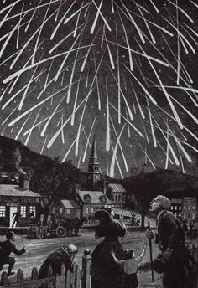
Stars Falling
  Hundreds of thousands of falling stars per hour
  Joseph Smith: "November 13. About 4 o'clock a.m. I was awakened by
  Brother Davis knocking at my door, and calling me to arise and behold
  the signs in the heavens. I arose, and to my great joy, beheld the stars fall
  from heaven like a shower of hailstones; a literal fulfillment of the
  word of God, as recorded in the holy Scriptures ...
  "The appearance was beautiful, grand, and sublime beyond description; and it seemed as if the artillery and fireworks of eternity were set in motion to enchant and entertain the Saints, and terrify and awe the sinners of the earth. Beautiful and terrific as was the scenery, it will not fully compare with the time when the sun shall become black like sack-cloth of hair, the moon like blood, and the stars fall to the earth (Rev. 6:12-13) — DHC 1:439-440.

Slide 41
Celestial Signs Given?
Are there enough Celestial Signs to fulfill Christ’s prophesy?
  Sign of Jonas: Sign of the Times--2017
  Sign of the Woman from the book of Revelation--2017
  Also the “Star of Bethlehem” reoccurrence in 2015—first time since 3-2 BC
    Conjunction of Venus, Jupiter, and Mars (Times of Israel)

Slide 42
Distress of Nations
War
Isaiah 13:15-18, Ezekial 32:11-13, Joel 2:11, Matt 24:6-7, Mark 13:8, Luke 21:10, 2 Nephi 23:15, D&C 45:63
End of Nations
D&C 87:6
Economic, Cultural, Political Turmoil

Slide 43
Global Distress
Neal A. Maxwell: Our time already reflects yet another prophecy: “Distress of nations, with perplexity”…Today, the assembled agonies of the world pass in reminding review on the nightly news.
  GC April 1988

Slide 44
Distress: War
D&C 45:30-33 And in that generation (times of gentiles fulfilled)…men will harden their hearts against me, and they will take up the sword, one against another and they will kill one another.
  Increase of wars in recent decades
  Over 7 million lives lost in current wars
  65.5 million refugees (50 million children) because of war
  Terrorism, school attacks, etc.

Slide 45
Distress: Financial
Destructive practices
  About 75% of Americans live paycheck to paycheck with zero savings
  Half of all children born today will be on food stamps in their lifetime
  49% of Americans are receiving benefits from a government program every month
  52% of American workers make less than $30,000 a year
  At one point the Fed was purchasing up to 70% of the bonds issued by the U.S. Treasury by printing money
  Stansberry Research

Slide 46
Distress: Political
America Political Prophesy
  Mosiah 29: 27 And if the time comes that the voice of the people doth choose iniquity, then is the time that the judgments of God will come upon you; yea, then is the time he will visit you with great destruction even as he has hitherto visited this land.
  “Gadianton robbers fill the judgement seats in many nations. An evil power seeks to overthrow the freedom of all nations and countries.” Elder Bruce R. McConkie, April 1980 General Conference

Slide 47
Distress: Religious
Religious liberty under attack
  And he said: Thus saith the Lord God—Cursed shall be the land, yea, this land, unto every nation, kindred, tongue, and people, unto destruction, which do wickedly, when they are fully ripe. Alma 45:16
  “Attacks on Religious Liberty in US Increase 133% in Last 5 Years”
  (First Liberty Institute)
  “If this is a sign of how religious liberty claims will be treated in the years ahead, those who value religious freedom have cause for great concern.”
  (Chief Justice Samuel Alito concerning forcing a family owned pharmacy to sell contraceptives USA Today August 1st, 2016)

Slide 48
Distress: Terrorism
9/11 Minor compared to potential attacks
  “Lights Out” by Ted Koppel
    Attacks on the nation’s power grid and infrastructure
      Physical Attack: poorly defended, few improvements.
      Cyberattack “The nation has little or no chance of withstanding a major cyberattack…When such an attack occurs, make no mistake, there will be major loss of life and serious crippling of National Security capabilities.
      April 2015: Security in the North American Grid—A Nation at Risk
      EMP Attack: Only one in ten would survive one year. 2008 Congressional Com. on impact of EMP attack
    Surviving the aftermath: three chapters on the Mormon church
      “No group of comparable size comes close to matching the scale and organizational discipline of the Mormons’ efforts to prepare for whatever catastrophe may come.”

Slide 49
Distress of Nations Detail
  Review of global distress
    Middle East (especially Israel)
    Asia (especially China)
    Russia
    Americas
    Sorry, no time to review facts and statistics now.

Slide 50
World Situation
  Is there sufficient Distress of Nations to fulfill Christ’s prophesy?

Slide 51
Natural Disasters
Earthquakes
Isaiah 13:13, Joel 2:10, 3:16, Matt 24:29, 24:7, Mark 13:8,Luke 21:11, Rev. 6:12-14, 8:5, 11:13 & 19, 16:18, 2 Nephi 23:13, 27:2, D&C 87:6
Hail/Fire
Isaiah 66:15-16, Rev. 8:7, D&C 29:16, 45:41
Famine, Plague, Pestilence
Matt 24:7, Mark 13:8, Luke 21:11, D&C 87:6
Sea, Thunder, Lightning
Luke 21:25, Rev 8:8-9, Rev. 8:5, 2 Nephi 27:2, D&C 87:6

Slide 52
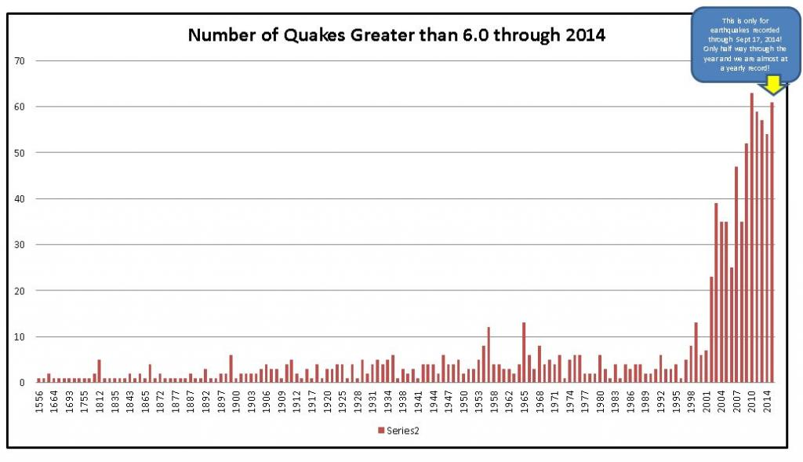
Earthquakes
D&C 45:30-33 And in that generation…there shall be earthquakes also in divers places, and many desolations
Reference to increasing frequency mentioned by General Authorities
  Pres. Ballard 1992, 1996
  Pres. Oaks 2004
98% chance of magnitude 7 quake in
Tokyo within 30 years (Tokyo Univ.)
California’s Eerie “Earthquake Pause” is unprecedented
  100 years without earth breaking earthquake
  "We do not think it's happened in the previous thousand years,“
  July 4th 6.4 and July 5th 7.1 in Ridgecrest

Slide 53
Earthquakes
    “New earthquake study says Utah is ripe for devastation”
      April 18, 2016 Salt Lake Tribune/Deseret News
    43% probability of 6.75 magnitude earthquake in the next 50 years
    2,000 to 2,500 deaths, with damages in the range of $33 billion.
    Expect aftershock of 6.0 within a day.
    Utilities, highways, communications severed, the main water line for SLC crosses the fault line 19 times. “Recovery is going to be excruciatingly slow.”
    Of the 757,400 buildings in the region about 182,000 will be moderately, extensively or completely damaged. Over 55,000 damaged beyond repair.
    “We’re pretty much certain that nobody’s going to have water for a long time” Even after 90 days HAZUS predicts more than 40% of the region’s households still won’t have potable water.
    No fuel from gas stations. All canyon roads inaccessible. All highways and freeways shut down for at least a month. Airport is on a high liquefaction zone and will be closed for weeks or a month.

Slide 54
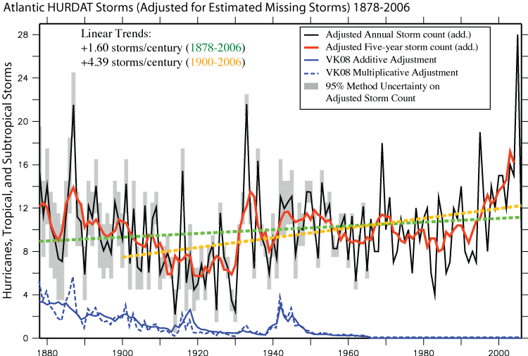
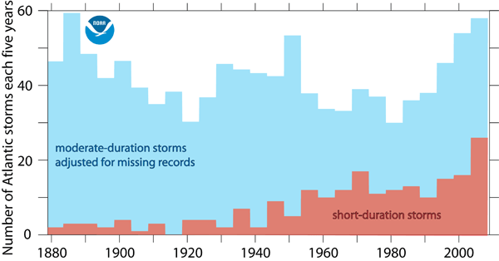
Weather Events
  “Sea and waves roaring”
    Tornadoes, tsunamis, flooding, hurricanes, increasing
    Natural disasters cost the country $91 billion in 2018, due to 14 events.
    Hurricane Barry, high Atlantic season predicted due to light El Nino

Slide 55
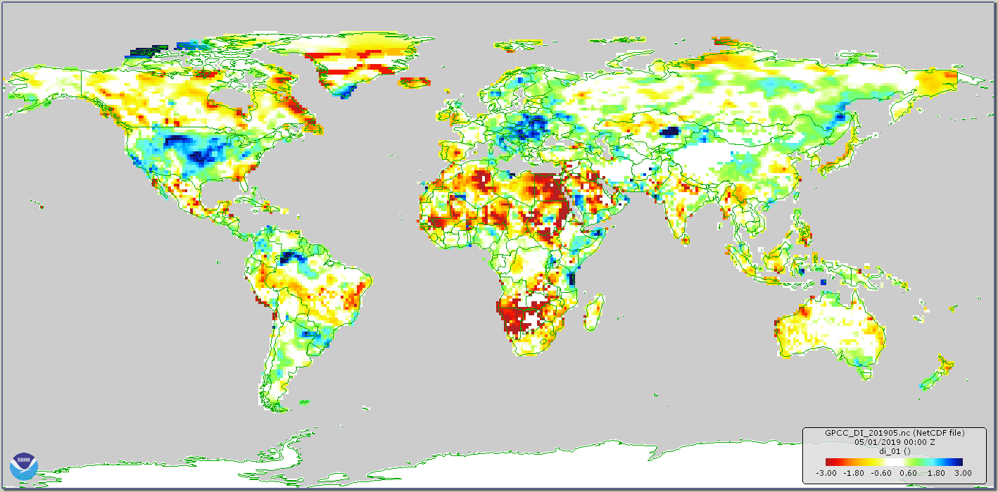
Famine
Drought Map

Slide 56
Plague
  D&C 45:31 And there shall be men standing in that generation (times of Gentiles fulfilled), that shall not pass until they shall see an overflowing scourge; for a desolating sickness shall cover the land.
  DCD: While we can’t predict exactly when or where the next epidemic or pandemic will begin, we know one is coming. “The world is unprepared” WHO director general Margaret Chan. Larry Brilliant 2006 TED talk, study of top epidemiologists: 90% expect a pandemic within the lives of their children or grandchildren where: 1 billion people would get sick, 165 million die, global recession and depression, $1-3 trillion cost to the economy.
  Antibiotic resistant bacteria—9/21/16 U.N. agrees to fight ‘the biggest threat to modern medicine’: antibiotic resistance. Superbugs now kill more than 700,000 people per year.
  Opioid Crisis
  U.S. Autism estimated at 1 in 68 births in 2014, up 119% from 2000 to 2010. 11% of American children (4-17) have ADHD according to CDC.

Slide 57
Natural Disasters
Are there sufficient natural disasters to fulfill the prophesy?
  “…and there shall be earthquakes in divers places, and there shall be famines and troubles: these are the beginning of sorrows.”
  Word for sorrows in Greek means birth pains—periodic pain, increasing in frequency as delivery approaches. From when the “times of the Gentiles fulfilled”?

Slide 58
Fear, Heaven’s Power Shaken
Fear
Luke 21:26, Rev 6:15-17
Elect Deceived
Matt. 24:24
Church Tried

Slide 59
Epidemic of Fear
Anxiety disorders are the most common mental illness in the U.S.
Affecting 40 million adults age 18 and older, or 18% of the population
(Source: National Institute of Mental Health)
    Generalized Anxiety Disorder 6.8 million adults
    Panic Disorder 6.0 million
    Social Anxiety Disorder 15.0 million
    Specific Phobias 19.0 million
    Obsessive-Compulsive Disorder 2.2 million
    Posttraumatic Stress Disorder 7.7 million
    Major Depressive Disorder 14.8 million
    Persistent Depressive Disorder 3.3 million

Slide 60
Fear: Persecution
Christian persecution 'at near genocide levels’
(BBC May 2019)
245 million Christians experience high levels of persecution, 1 in 9
Each month 345 Christians are killed, 105 churches attacked

Slide 61
Heaven’s Power Shaken: Apostasy
Overall reduction in religious observance
  Pew Survey 2015: Christians down 8% in America, unaffiliated up 6% since 2007
  By 2050 the number of Muslims will be equal to the number of Christians globally

Slide 62
Heaven’s Power Shaken: Sin
Neal A. Maxwell: The last days will be rampant with the cardinal sins, just “as in the days of Noah.” Society in the days of Noah, scriptures advise, was “corrupt before God” and “filled with violence.” Corruption and violence—sound familiar? Both of these awful conditions crest because of surging individual selfishness. When thus engulfed, no wonder men’s hearts in our day will fail them because of fear. (See Luke 21:26) Even the faithful can expect a few fibrillations. GC Oct 1990

Slide 63
Heaven’s Power: Shaking?
Could God and His angels inflict all of the judgments on earth through the sun and stars? (D&C 88:7)
Approaching a solar minimum
Phenomena potentially caused by sun, moon, stars (asteroids)
    Earthquakes
    Storms and troubled seas, waves
    Drought and famine
    Chaos and warfare (disease?)
    Loss of electricity (EMP), Darkness
    Volcanoes or asteroid strike

Slide 64
Fear and Heaven’s Power
Is there enough fear in the world for Christ’s prophesy to be fulfilled?
Are the heaven’s power being shaken?

Slide 65
Preparation
Mental, Emotional Preparation
Physical Preparation
Spiritual Preparation

Slide 66
Now is the Time
  “While we are powerless to alter the fact of the Second Coming and unable to know its exact time, we can accelerate our own preparation and try to influence the preparation of those around us. We are living in the prophesied time “when peace shall be taken from the earth, when “all things shall be in commotion” and “men’s hearts shall fail them.” (President Oaks, April 2004 General Conference)
  Has he changed his mind since 2004?

Slide 67
Trust Him!
“We are, therefore, not ignorant of the challenges of the world, nor are we unaware of the difficulties of our times. But this does not mean that we should burden ourselves or others with constant fear. Rather than dwelling on the immensity of our challenges, would it not be better to focus on the infinite greatness, goodness, and absolute power of our God, trusting Him and preparing with a joyful heart for the return of Jesus the Christ?” Pres. Uchtdorf 4/17

Slide 68
Cast off fear!!
"It's that period of time when things get really bad. Fortunately it won't be in my lifetime, but if it were, I would just hope to die quickly".
By living in fear of the Days of Tribulation, you have given in to one of the adversaries' greatest deceptions, and have undermined God's tremendous power and ability to intervene in your life.
If you want to die then it is your lack of faith that will not be sufficient to save you, not that you will be the victim of some horrible event. With all due respect, you are trifling with the covenants you have entered into and do not understand the power and significance of the Abrahamic Covenant and God's obligation to save his posterity, nor can you truly believe in the enabling and empowering aspects of Jesus Christ's atonement.
If we boldly face what appear to be the giant tribulations of the last days, we like David and his giant will overpower them in the name of the God of Israel, under the power of his covenants with Abraham, Isaac, and Jacob. We can and will overcome the elephant tribulations if we begin to acknowledge they lie on our doorstep and not some ephemeral horizon of the future, and if we arm ourselves with righteousness and the power of God (1 Ne. 14:14), and confidently face what lies ahead knowing in whom we trust.
Eric Smith: Doctrinal “Elephants in the Room” – Facing the Days of Tribulation with Confidence

Slide 69
Prepare!
Are We Prepared? President Monson, September Ensign 2014
  Parable of the scared chickens
  …every family in the Church to have a supply of food, clothing, and, where possible, other necessities of life.
  …looking to the condition of your finances.”
  Are we prepared for the emergencies in our lives?
  Are our skills perfected? Do we live providently?
  Do we have our reserve supply on hand?
  Are we obedient to the commandments of God? Are we responsive to the teachings of prophets?
  Are we prepared to give of our substance to the poor, the needy? Are we square with the Lord?
  …it behooves us to prepare for uncertainties.
When the time for decision arrives, the time for preparation is past.

Slide 70
Physical Preparation
  No expensive measures—be wise (Pres. Cook)
  Stake and Ward Preparations
  Personal Preparations
    providentliving.org
    101 Home Storage Centers
  Details require other sessions

Slide 71
Prepare for Where?
Many saints will likely will gather from their homes to “places of safety”, which we may consider in our preparations
  Historical precedence
    See the scriptures
  Prophetic statements: Joseph Smith, Harold B. Lee
    “But you and I know that the Lord has prepared places of safety to which He is eager to guide us. I think of that often.”
    Henry B. Eyring
  Realistic expectations
  No time to review in detail!

Slide 72
Spiritual Preparation
  “We need to make both temporal and spiritual preparation for the events prophesied at the time of the Second Coming. And the preparation most likely to be neglected is the one less visible and more difficult—the spiritual. A 72-hour kit of temporal supplies may prove valuable for earthly challenges, but, as the foolish virgins learned to their sorrow, a 24-hour kit of spiritual preparation is of greater and more enduring value.” Pres. Oaks, 4/04
  “In coming days, it will not be possible to survive spiritually without the guiding, directing, comforting, and constant influence of the Holy Ghost.” Pres. Nelson

Slide 73
Keep Your Covenants
  Keep your Covenants and the Commandments
    Priesthood
    Sabbath
    Temple
    Tithing

Slide 74
Follow the Prophet
  Bruce R. McConkie: “In every age the Lord gives his people the direction they need at the moment of their peril and danger. And surely in the days ahead there will be times when nothing but the wisdom of God, descending from heaven and flowing from prophetic lips will be able to save his people.” A New Witness for the Articles of Faith (Deseret Book Company, 1985), 478
  Is every recent change in the church designed to help us prepare?
    Gather Israel
    Home centered church
    Priesthood quorums combined
    Temple changes
    Ministering

Slide 75
Exercise Your Priesthood
  Pres. Nelson: In a coming day, only those men who have taken their priesthood seriously, by diligently seeking to be taught by the Lord Himself, will be able to bless, guide, protect, strengthen, and heal others. Only a man who has paid the price for priesthood power will be able to bring miracles to those he loves and keep his marriage and family safe, now and throughout eternity. (CR April 2016)

Slide 76
The Lord Will Prevail
“We know for certain that if and when everything else in the latter days is down or dying; if governments, economies, industries, and institutions crumble; if societies and cultures become a quagmire of chaos and insecurity, nevertheless, through it all the gospel of Jesus Christ and The Church of Jesus Christ of Latter-day Saints that bears that gospel to the world will stand triumphant. It will stand undefiled in God’s hand until the very Son of God Himself comes to rule and reign as Lord of lords and King of Kings. Nothing is more certain in this world. Nothing is more sure.”
Jeffrey R. Holland, Church Education System Broadcast, Feb. 6, 2015

Slide 77
Finally… (Slide 77)
Are you watching?
Do you see the signs?
Is there oil in your lamp?

Slide 78
Signs Summary
2000
2002
2004
2006
2008
2010
2012
2014
2016
2018
2020
2022
2024
2017
5777
Generation from “Time of Gentiles Fulfilled” 1967 to 2037
Return of Jews—Jerusalem for 50 years (Jubilee), Israel 70 years
Gospels
7 Years
Sign of Jonah?
Sign of Jonah?
Star of Bethlehem?
3.5 Years
3.5 Years
Tribulations
Beginning of Sorrows
About half hour of silence in the Heavens before Tribulations (About 20.8 Years)
7th Seal
Opens
Woman (Church) Protected for 1260 days (3.5 years)—March 5, 2021
Revelation
Sign of Woman

Slide 79
Practice Ministering
    “There are those who associate high calling in the church with the guaranteed rights to the blessing of heaven. But I wish to declare, without reservation, that the ultimate judgment of every man will be on the simplest of terms. And most certainly on what each has done to bless other people in a quiet, unassuming way.” Robert L. Simpson

Slide 80
Matthew Generations Timeline
4000 BC
3000
2000
1000
0
1000 AD
2000
3000
Adam
3761--2831
Current Gen.
2019
7 gen.
Abraham
1813-1638
Covenant 1743
(2018 Yrs. after Creation)
7 gen.
Enoch
3138—(2773)
Joseph Smith*
1805-1844
10 gen.
10 gen.
14 gen.
10 gen.
David
1010-970
Founders of America*
1776
Noah
2704—1754
Flood 2150
14 gen.
Carrying Away to Babylon
587
14 = A whole or complete unity as expressed in the body of Messiah
*Joseph Smith 8 generations to Mayflower,
4th cousin 2x removed signed Constitution, 4th cousin 3x removed signed Declaration of Independence
14 gen.
Christ
4-1 BC—30-33 AD

